Slide 1
SRI SIVASUBRAMANIYA NADAR COLLEGE OF ENGINEERING
SSN RESEARCH INTERNSHIP 2022
Efficient Irrigation System for Water Sustainability using Machine Learning
Project ID: IT13
Mentor
Dr. I. Joe Louis Paul M.E., Ph.D.,
Associate Professor
Department of Information Technology
SSN College of Engineering
Presented by
Roheth S,
II Year
Department of Information Technology
Sri Venkateswara College of Engineering

Slide 2
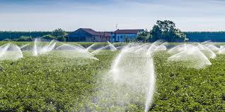
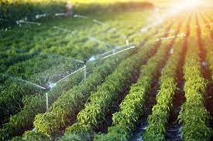
Overview (1/3)
• Irrigation is applying water to crops artificially to fulfill their water requirements.
• Irrigation offers moisture required for growth and development, germination, and other related functions.

Slide 3


Overview (2/3)
Sustainability improves the quality of our lives, protects our ecosystem, and preserves natural resources for future generations.
Water is one of the planet's most important resources. Responsible water use is essential in the current situation.

Slide 4
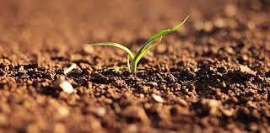
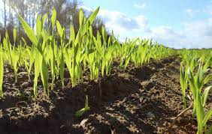
Overview (3/3)
More than 75% of freshwater resources are used for irrigation; therefore, efficient water use in irrigation systems using modern technology is essential.
Machine learning algorithms will predict whether irrigation is required based on soil moisture, soil temperature, air temperature, and humidity data.

Slide 5

Problem Statement
To develop an effective irrigation model that can predict whether a crop needs irrigation or not depending on input parameters.

Slide 6
Scope
This system provides the farmer with irrigation prediction for the crop.
This system promotes water sustainability in irrigation.

Slide 7
Limitations
Machine learning algorithms need to train on a large scale, as well as on region-specific data.
Crop formatted data is unavailable.
The available data determine the accuracy of the model forecast.

Slide 8
Literature Review (1/2)
S.No | Authors | Title | Year | Methodology | Limitations
1 | AnnekethVij, Vijendra , Abhishek, Shivam, Aashima, Aarushi | IoT and Machine Learning Approaches for Automation of Farm Irrigation System. | 2019 | Deploying ML in agriculture helps in controlling, optimizing farm practices, and predicting the weather and rainfall. | Algorithm works only on available data.
2 | Akshay S and T K Ramesh | Efficient Machine Learning Algorithm for Smart Irrigation. | 2020 | Agriculture yield gets affected by many parameters, and some of the important parameters are fertility of soil, climatic conditions, water availability. | No pre-Trained model.
3 | Himanshu Nandanwar, Anamika Chauhan, Dushyant Pahl, Harshit | A Survey of Application of ML and Data Mining Techniques for Smart Irrigation System. | 2020 | With AI, weather conditions, water usage, and soil condition can be analyzed by farmers for better decision. | Continuous internet connection is required.

Slide 9
Literature Review (2/2)
S.No | Authors | Title | Year | Methodology | Limitations
4 | Dushyant, Rajeev Sobti, Praveen, Sachin , Pradeep, and Kayhan Zrar Ghafoor | IoT-Driven Model for Weather and Soil Conditions Based on Precision Irrigation Using Machine Learning. | 2022 | Support vector machine (SVM), K-nearest neighbor (KNN), and Gaussian naive Bayes (NB) are some of the ML algorithms, which are used in majority of the agriculture practices. | Lack of available data.
5 | Angelin Blessy , Anveesh kumar | Smart Irrigation System Techniques using Artificial Intelligence and IoT . | 2021 | Detailed smart farming approach had been described, all the challenges, enablers and opportunities were discussed. | Risks of unemployment.
6 | Joao Cardoso, Andre Gloria Pedro Sebastiao | A Methodology for Sustainable Farming Irrigation using WSN, NB-IoT and Machine Learning. | 2020 | Comparative study of multiple linear regression and Support vector regression and random forest regression was carried out. | High cost for implementation.

Slide 10
Expected Outcome
Based on particular input parameters, the system is trained to predict whether the crop requires irrigation or not.
This strategy eliminates over-irrigation and soil erosion while also promoting water sustainability.

Slide 11
Research Methodology
Performing feature engineering to extract the features from the raw data.
Display the prediction results, whether irrigation is required or not.
DATA COLLECTION
DATA PROCESSING
ML MODELING
RESULT
The dataset is collected from GitHub.
Compare SVM, KNN, and NB algorithms.

Slide 12
Research Plan
Understanding the aim and objective of the research.
Collecting appropriate datasets to obtain the training samples.
Testing the input samples.
Testing the accuracy and precision.
Creating a Machine Learning model to predict whether irrigation is required.

Slide 13
References
A. Sharma, A. Jain, P. Gupta, and V. Chowdary, “Machine learning applications for precision agriculture: a comprehensive review,” IEEE Access, vol. 9, pp. 4843–4873, 2021.
Liakos, P. Busato, D. Moshou, S. Pearson, and D. Bochtis, “Machine learning in agriculture: a review,” Sensors, vol. 18, no. 8, p. 2674, 2018.
R. Priya and D. Ramesh, “ML based sustainable precision agriculture: a future generation perspective,” Sustainable Computing: Informatics and Systems, vol. 28, no. 100439, Article ID 100439, 2020.
Y. Mekonnen, S. Namuduri, L. Burton, A. Sarwat, and S. Bhansali, “Review-machine learning techniques in wireless sensor network based precision agriculture,” Journal of the Electrochemical Society, vol. 167, no. 3, Article ID 037522, 2019.
M. Bacco, A. Berton, E. Ferro, C. Gennaro, A. Gotta, S. Matteoli, F. Paonessa, M. Ruggeri, G. Virone, A. Zanella, Smart farming: Opportunities, challenges and technology enablers, 2018 IoT Vert. Top. Summit Agric. - Tuscany, IOT Tuscany, 2018.
M. Van Rooyen, N. Luwes, E. Theron, Automated soil classification and identification using machine vision, 2017 Pattern Recognit. Assoc. South Africa Robot. Mechatronics Int. Conf. PRASA-RobMech, 2018.

Slide 14


